Slide 1
MULTI-SCALE FEATURE FUSION: LEARNING BETTER SEMANTIC SEGMENTATION FOR ROAD POTHOLE DETECTION
By Jiahe Fan , Mohammud J. Bocus , Brett Hosking , Rigen Wu , Yanan Liu, Sergey Vityazev , Rui Fan
Reviewed By
Name: Md Fuad Islam, Id: 20101060, Section:01
Course code: CSE438

Slide 2
Problem Statement:
To detect potholes in roads using
multi-scale feature fusion module based on attention mechanism
for preventing road accidents

Slide 3
Related semantic segmentation techniques:
PSPNet introduces a spatial pyramid pooling (SPP) module to collect contextual information in different scales.
SE-Net employs a squeeze-excitation operation to integrate the global contextual information into a feature weight vector and reweigh the feature maps.
EcnNet uses a context encoding module to obtain a globally-shared feature weight vector.

Slide 4
There are certain techniques that produces two layers
Where top layer consists of rich semantic information and
the lower layer feature maps contains fine-grained information.
How to utilize both layer to improve prediction??

Slide 5
Contribution:
Here a novel multi-scale feature fusion module is introduce
to reweight feature maps in different layers
which removes the semantic gap

Slide 6
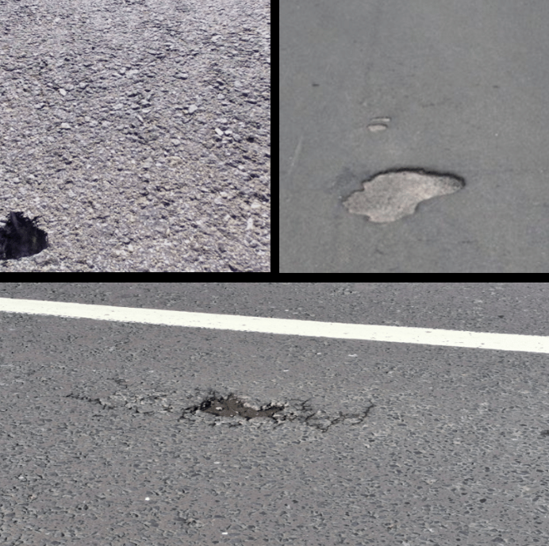
Dataset:
Pothole-600

Slide 7
Implementation:
Multi-scale feature fusion
Channel-wise feature reweighting

Slide 8
Multi-scale feature fusion:
Using matrix multiplication we find the relevance of feature maps.
The greater the relevance, higher the similarity will be.
Channel-wise feature reweighting:
Using global average pooling layer, ReLU, Sigmoid we determine weights for the feature maps.

Slide 9
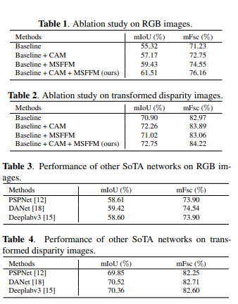
Conclusion:
The proposed methods outperforms other
SoTA techniques for both RGB and
transformed disparity images

